Slide 1
A HYBRID APPROACH FOR IDENTIFICATION OF MANHOLE AND STAIRCASE TO ASSIST VISUALLY CHALLENGED
Dilna V
Class no:24 S7 Btech CSE
26 SEPTEMBER,2018

Slide 2
CONTENTS
A HYBRID APPROACH FOR IDENTIFICATION OF MANHOLE AND STAIRCASE TO ASSIST VISUALLY CHALLENGED
INTRODUCTION
HARDWARE COMPONENTS
IDENTIFICATION OF MANHOLES
STAIRCASE DETECTION
SURF ALGORITHM
BIVARIATE GAUSSIUN MIXTURE MODEL
CONCLUSION
REFERENCES

Slide 3
INTRODUCTION
A HYBRID APPROACH FOR IDENTIFICATION OF MANHOLE AND STAIRCASE TO ASSIST VISUALLY CHALLENGED
Staircases and manholes pose a major problem in navigation.
Their recognition is of prime importance for the visually impaired.
A Hybrid approach for detecting manholes and staircases by
Sensors
Image based algorithms

Slide 4
INTRODUCTION(Contd..)
A HYBRID APPROACH FOR IDENTIFICATION OF MANHOLE AND STAIRCASE TO ASSIST VISUALLY CHALLENGED
Ultrasonic sensors
Upward and downward staircase detection using BGMM
Distance features extraction using SURF algorithm
Median based threshold using BGMM
Audio feedback.
Vibro-feedback

Slide 5
HARDWARE COMPONENTS
A HYBRID APPROACH FOR IDENTIFICATION OF MANHOLE AND STAIRCASE TO ASSIST VISUALLY CHALLENGED
Ultra sonic sensors
Arduino processor
Vibrator
Sensor range
HC-05 Bluetooth
Notes:
Direct based on rgb color spaces of the skin color
Indirect using data glove

Slide 6
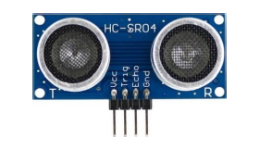
ULTRASONIC SENSORS
A HYBRID APPROACH FOR IDENTIFICATION OF MANHOLE AND STAIRCASE TO ASSIST VISUALLY CHALLENGED
Helps to identify the distance.
Consist of 4 pins
Vcc-5V
Trig
Echo
GND
Distance = (Time for wave to return * Speed of sound) / 2
Courtesy:https://ieeexplore.ieee.org/document/831465

Slide 7

VIBRATOR
A HYBRID APPROACH FOR IDENTIFICATION OF MANHOLE AND STAIRCASE TO ASSIST VISUALLY CHALLENGED
Mechanical device.
Used to generate vibration when the blind person is also deaf.
Electric motor with an unbalanced mass on its driver shaft.
Courtesy:https://ieeexplore.ieee.org/document/831465

Slide 8
SENSOR RANGE
A HYBRID APPROACH FOR IDENTIFICATION OF MANHOLE AND STAIRCASE TO ASSIST VISUALLY CHALLENGED
Objects within the range of 3m.
Objects towards the angle of 90 degree.
Estimate the distance between two sensors.
Value of first sensor is higher than second sensor
it is estimated as an object.
Ultrasonic sensors are attached to the PVC pipe.
Low pass filters are used.
Mean and standard deviation are extracted.

Slide 9

ARDUINO
A HYBRID APPROACH FOR IDENTIFICATION OF MANHOLE AND STAIRCASE TO ASSIST VISUALLY CHALLENGED
Single-board microcontrollers and microcontroller kits.
Used in digital devices which
can sense and control objects.
Digital input and analog output.
Pre-programmed boot loader.
Courtesy:https://ieeexplore.ieee.org/document/8314695

Slide 10
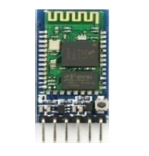
HC-05 BLUETOOTH
A HYBRID APPROACH FOR IDENTIFICATION OF MANHOLE AND STAIRCASE TO ASSIST VISUALLY CHALLENGED
Wireless serial connection.
Establishes master-slave configuration.
By default it works as a slave.
Can be configured by AT commands.
Enhance datarate.
Better transmission
Courtesy:https://ieeexplore.ieee.org/document/831465

Slide 11
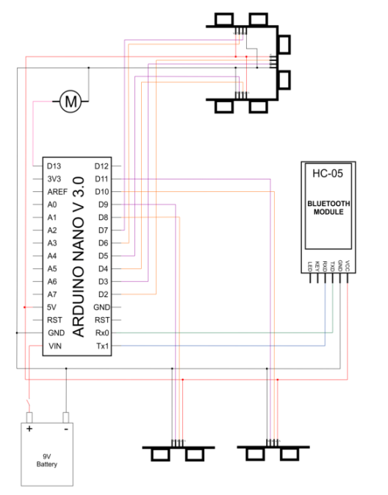
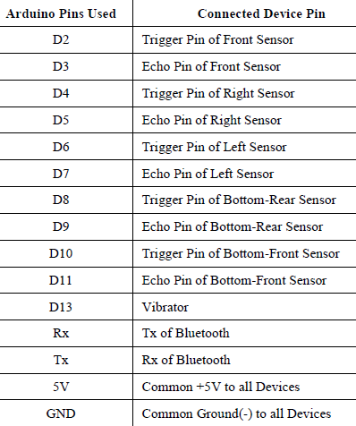
SCHEMATIC DIAGRAM
A HYBRID APPROACH FOR IDENTIFICATION OF MANHOLE AND STAIRCASE TO ASSIST VISUALLY CHALLENGED
Courtesy:https://ieeexplore.ieee.org/document/831465

Slide 12
IDENTIFICATION OF MAN HOLES
A HYBRID APPROACH FOR IDENTIFICATION OF MANHOLE AND STAIRCASE TO ASSIST VISUALLY CHALLENGED
Hybrid method using the threshold values.
The manhole sensor reads the signals from time to time.
The vacuum is identified.
Reflects the signal back through the ultrasonic waves.
Vacuum is then converted into distance.
Distance = (speed * time) / 2
speed of sound in air = 340 m/s.

Slide 13
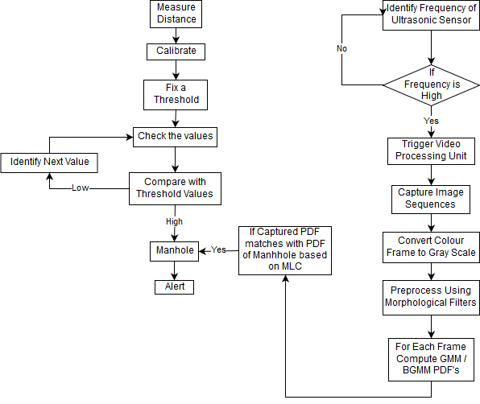
ARCHITECTURE OF MANHOLE DETECTION
A HYBRID APPROACH FOR IDENTIFICATION OF MANHOLE AND STAIRCASE TO ASSIST VISUALLY CHALLENGED
Courtesy:https://ieeexplore.ieee.org/document/831465

Slide 14
THRESHOLD VALUES
A HYBRID APPROACH FOR IDENTIFICATION OF MANHOLE AND STAIRCASE TO ASSIST VISUALLY CHALLENGED
Various patterns of holding the stick.
Avg-value = (sum of 10 values) / 10.
Threshold = maximum among the avg-values.
Threshold value is compared with the distance value.
Values above the threshold considered as manhole.

Slide 15
THRESHOLD VALUES(CONT..)
A HYBRID APPROACH FOR IDENTIFICATION OF MANHOLE AND STAIRCASE TO ASSIST VISUALLY CHALLENGED
Performance is tested using 3 metrics.
Precision
Recall
F-measure
Precision = TP/ (TP+FP)
Recall=TP/ (TP+FN)
F-Measure=(Precision * Recall)/ (Precision +Recall)

Slide 16
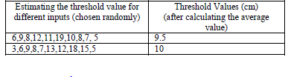
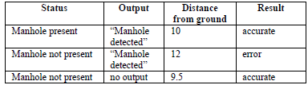
THRESHOLD VALUES(CONT..)
A HYBRID APPROACH FOR IDENTIFICATION OF MANHOLE AND STAIRCASE TO ASSIST VISUALLY CHALLENGED
ESTIMATION OF THE THRESHOLD VALUE
ESTIMATION OF THE MANHOLE
Courtesy:https://ieeexplore.ieee.org/document/831465
Dept of CSE,MACE Kothamangalam
16

Slide 17
THRESHOLD IDENTIFICATION BASED ON MEDIAN VALUE
A HYBRID APPROACH FOR IDENTIFICATION OF MANHOLE AND STAIRCASE TO ASSIST VISUALLY CHALLENGED
The ultrasonic sensor activates for the pulse of 10μs.
Two transducers
Triggers the video processing unit.
Starts capturing the image sequences.
filtering process removes the noise.
Then attribute extraction.
Object identification.

Slide 18

GMM FOR MANHOLE DETECTION
Whole image modeled by a mixture of ‘k’ component Gaussian distributions.
The probability density function of the model is given by:
πi, i = 1,2,3, . . , k.
xi - image pixels
πi - mixing weight
θ=(μi, σi )

Slide 19
STAIRCASE DETECTION
A HYBRID APPROACH FOR IDENTIFICATION OF MANHOLE AND STAIRCASE TO ASSIST VISUALLY CHALLENGED
Dual strategy
Image based strategy
Ultrasonic sensor based
SURF based staircase detection.
BIVARIATE GUASSUIN MIXTURE MODEL
Ultrasonic sensor based staircase detection

Slide 20
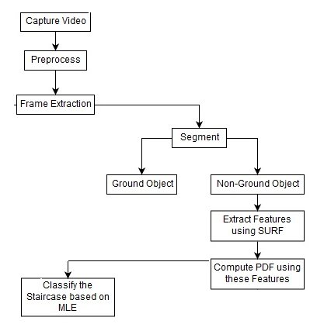
IDENTIFICATION OF STAIRCASE
A HYBRID APPROACH FOR IDENTIFICATION OF MANHOLE AND STAIRCASE TO ASSIST VISUALLY CHALLENGED
Courtesy:https://ieeexplore.ieee.org/document/831465

Slide 21
SURF BASED STAIRCASE DETECTION
A HYBRID APPROACH FOR IDENTIFICATION OF MANHOLE AND STAIRCASE TO ASSIST VISUALLY CHALLENGED
SPEED UP ROBUST FEATURES
Illumination
Rotation
Scale
Computational simplicity
Faster
Feature extraction based on attributes like blobs, corners etc.

Slide 22
SURF ALGORITHM
A HYBRID APPROACH FOR IDENTIFICATION OF MANHOLE AND STAIRCASE TO ASSIST VISUALLY CHALLENGED
Real-world images are stored .
Comparison with the template image.
Identification of Key points.
Corners
Blobs
Edge
The smallest Euclidean distance between the same points.
A Hessian matrix for blob detection or feature extraction.
Figure out the minima and maxima associated with the intensity.

Slide 23
BIVARIATE GAUSSIAN MIXTURE MODEL
BGMM classifier is able to handle bivariate features.
Help to identify steps which are ascending or descending.
The probability distribution function of pixel intensities is given by
-1 <= ρ<=1.
Courtesy:https://ieeexplore.ieee.org/document/8314694

Slide 24
ULTRASONIC SENSOR BASED STAIRCASE DETECTION
Actual navigation through the staircase.
Precise control
Two sensors distinguish horizontal planes
Variation of depth of these planes.
Captures signals in the form of a frequency curve.
Arduino processor acts as processing unit.

Slide 25
CONCLUSION
WEARABLE HAND DEVICE FOR SIGN LANGUAGE INTERPRETATION
Identification of ascending/descending staircases
Helps to navigate them by vibration and audio alert feedback
Low cost prototype
Affordable
Simple

Slide 26
REFERENCES
WEARABLE HAND DEVICE FOR SIGN LANGUAGE INTERPRETATION
[1] Gutmann J.S., Fukuchi M. and Fujita M., “Stair Climbing for Humanoid Robots Using Stereo Vision”, IEEE/RSJ International Conference on Intelligent Robots and Systems, vol. 2, pp. 1407-1413, 2004.
[2] Yang Cong Y. T., Li X. And Liu J., "Stairway Detection Algorithm based on Vision for UGV Stair Climbing", IEEE International Conference on Networking Sensing and Control (ICNSC 2008), pp. 1806-1811, 2008.
[3] Cáceres Hernández D. and Jo K. H., "Stairway Tracking Based on Automatic Target Selection Using Directional Filters", 17th Korea-Japan Joint Workshop on Frontiers of Computer Vision (FCV), Ulsan, pp. 1-6, 2011.
[4] Hesch J.A., Mariottini G. L. and Roumeliotis S.I., "Descending-stair Detection, Approach, and Traversal with an Autonomous Tracked Vehicle", IEEE/RSJ International Conference on Intelligent Robots and Systems, Taipei, pp. 5525-5531, 2010.

Slide 27
REFERENCES(Contd..)
WEARABLE HAND DEVICE FOR SIGN LANGUAGE INTERPRETATION
[5] Se S. and Brady M., “Vision-based Detection of Stair-Cases”, Proceedings of Fourth Asian Conference on Computer Vision (ACCV), pp. 535-540, 2000.
[6] Lu X. and Manduchi R., “Detection and Localization of Curbs and Stairways Using Stereo Vision”, International Conference on Robotics and Automation, pp. 4648-4654, 2000.
[7] Lee Y. H., Leung T. S. and Medioni G., "Real-Time Staircase Detection From a Wearable Stereo System", Proceedings of the 21st International Conference on Pattern Recognition (ICPR2012), Tsukuba, pp. 3770-3773, 2012.
[8] Kim D., Kim K. and Lee S., “Stereo Camera Based Virtual Cane System with Identifiable Distance Tactile Feedback for the Blind”, Sensors, vol.14, No. 6, pp. 10412-10431, 2014.
[9] Wang S. and Tian Y., “Detecting Stairs and Pedestrian Crosswalks for the Blind by RGDB Camera”, IEEE International Conference on Bioinformatics and Biomedicine Workshops, pp. 732-739, 2012.
[10] Munoz R., Rong X., and Tian Y., “Depth-aware Indoor Staircase Detection and Recognition for the Visually Impaired”, IEEE International Conference on Multimedia & Expo Workshops (ICMEW), Seattle, WA, pp. 1-6, 2016.

Slide 28
THANK YOU

